Slide 1

The Story Behind the
World’s Largest 3D Printed Aircraft
22 April 2014
Notes:
Jean

Slide 2

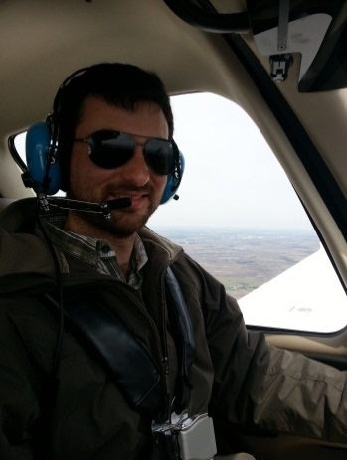
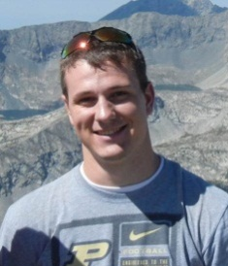
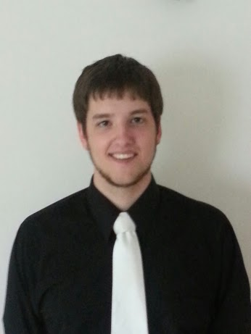

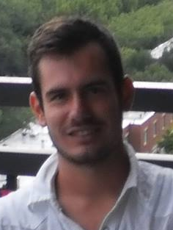

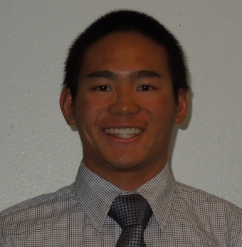

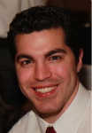

Meet the Team
Jean Ruggiero
Purdue
Nicolaus Caniza
Purdue
Stephen Lutgring
Purdue
Michael Kelley
Purdue
Ignacio Jose Benitez Cruz
Purdue
Roman Esteban Hofer
Purdue
Scott Ashcraft
Georgia Tech
Aaron Inouye
BYU
Tanveer Chandok
Georgia Tech
Michael Miles
BYU
2
Notes:
Jean

Slide 3
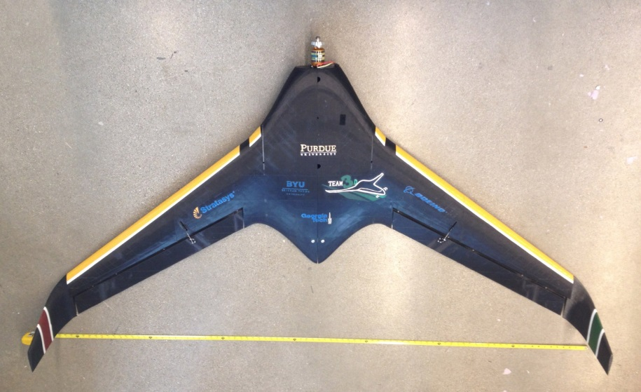
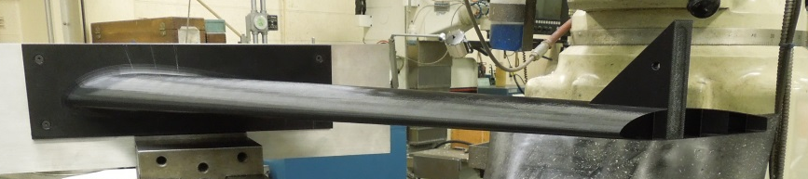
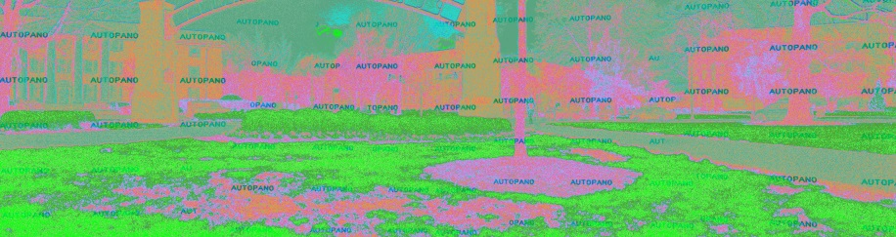
Agenda
System overview
Detailed Design
Detailed Analysis
Testing
Manufacturing
Cost Update
Lessons Learned
Conclusion
3
Notes:
Jean

Slide 4
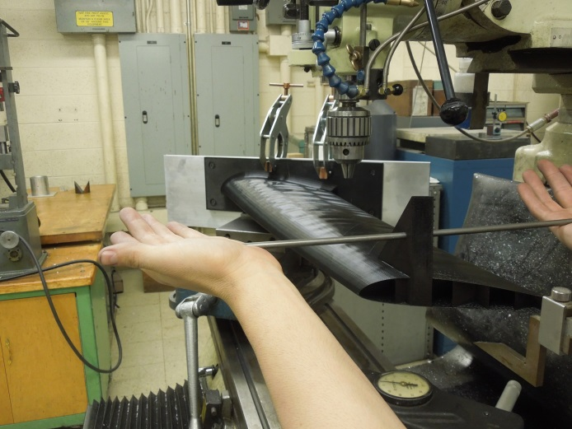
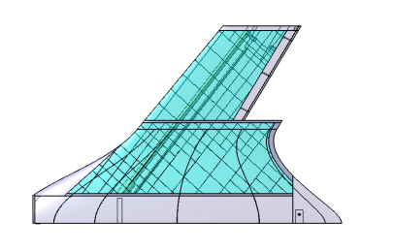

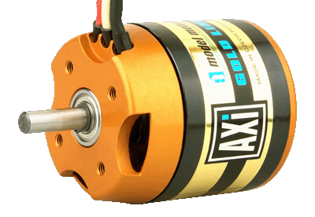
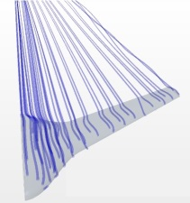
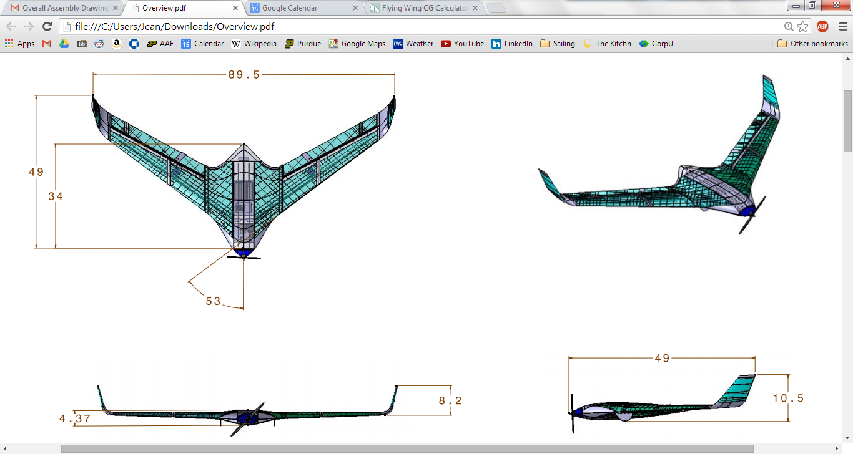

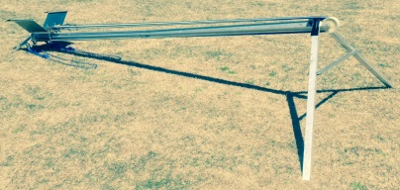
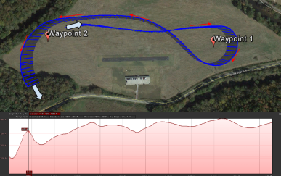

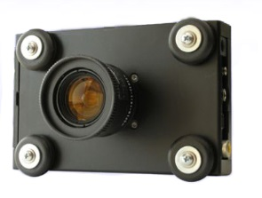
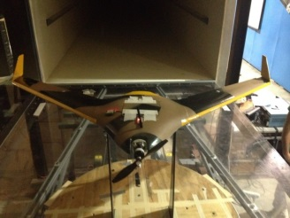
Boeing AerosPACE Course
Multi-university collaboration to produce UAS for agricultural imaging.
4
Notes:
Jean

Slide 5
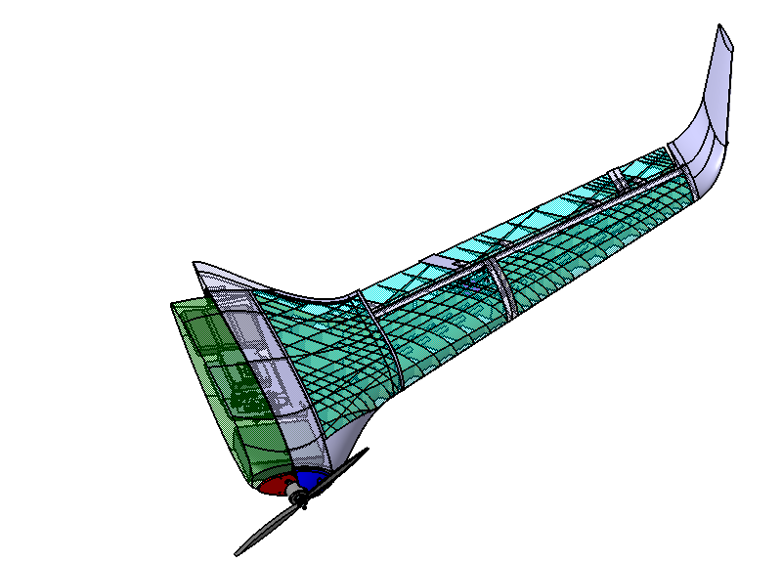
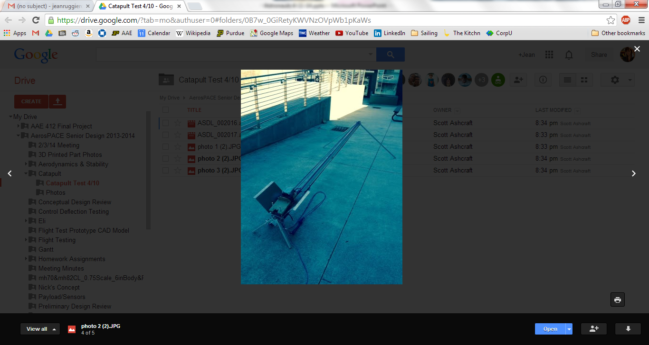
System Overview
Elevon control surfaces
Catapult launcher
Winglets for yaw stability
Battery compartment
3D printed skin & internal structure
Tetracam for agricultural imaging
Avionics bay
AXI 4130/16 electric motor
5
Notes:
Jean

Slide 6
Specifications
Planform Area: 7.83 ft²
Aspect Ratio: 7.1
Gross Weight: 11.7 lb
Powerplant: AXI 4130/16 w/16x8” prop
6
Notes:
Jean

Slide 7
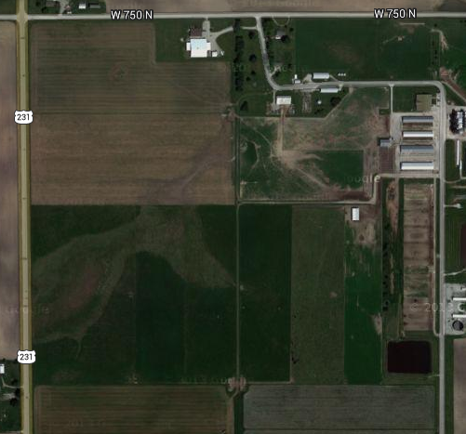
Mission Overview
Goal: Provide aerial imaging capability for agricultural applications.
Launch & Recovery
(100’ x 100’)
Cruise
(1 mile)
Reserve
(15 min)
Mission Area
(60 acres)
Cruise
(1 mile)
Notes:
Jean

Slide 8
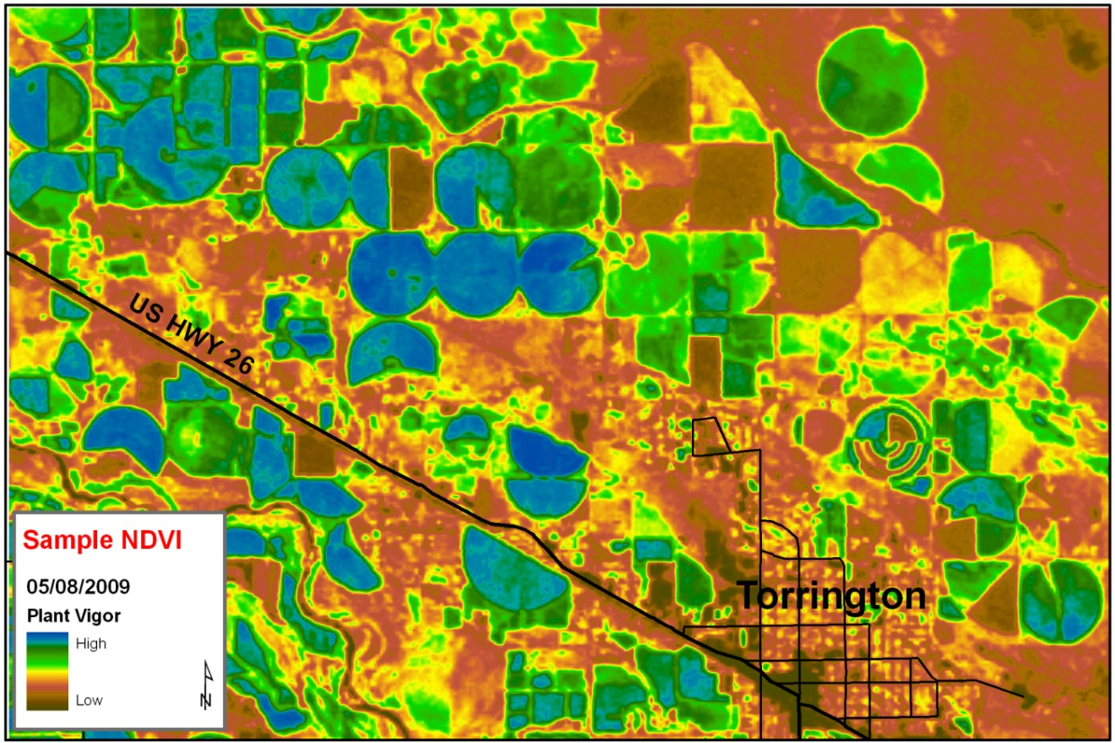
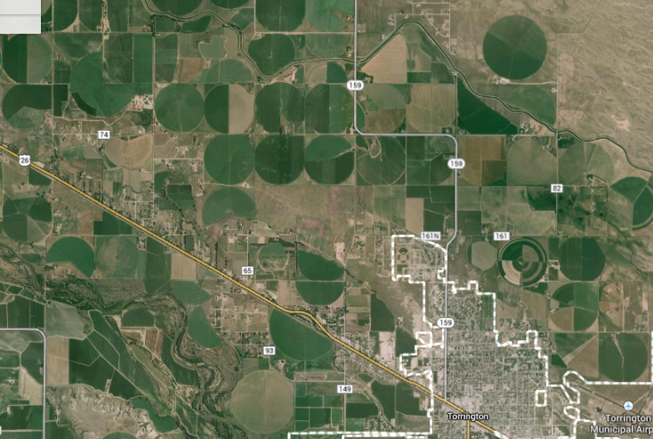
Normalized Difference Vegetation Index
Sample NDVI image of large area taken from GA aircraft.
Notes:
Jean

Slide 9
Detailed Design
9

Slide 10
Aerodynamics
10
Notes:
Mike K
Graphs of WT, CFD, XFLR5

Slide 11
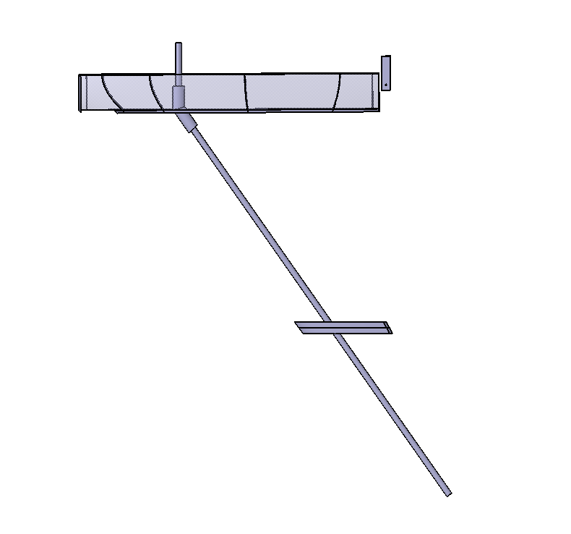
Structural Layout
Fwd Body Spar (CF)
Aft Connector
Motor Mount Bulkhead
Payload Module
Elbow Joint
Secondary Wing Spar (3D Printed)
Wing Joint Bulkhead
Main Wing Spar (CF)
11
Notes:
Mike K

Slide 12
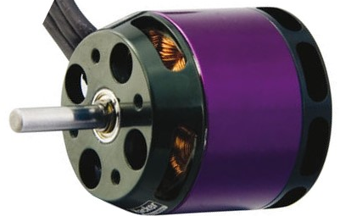
Propulsion System
Final aircraft weight 4 lbs heavier than initial predictions
New propulsion system was needed for take-off
 | Initial Configuration | Final Configuration
Motor | Hacker A40-12S | AXI 4130/16
Battery | LiPo 3S-3P (20C) | LiPo 6S-1P (50C)
Propeller | 14x10” | 16x8”
Static Thrust | 5 lbs | 8.6 lbs
12
Notes:
Mike K
Motocalc graphs – include old & new systems

Slide 13
Stability & Control
13

Slide 14
Weight & Balance
CG is located 23.4 in aft of nose for static margin of 15%.
23.4”
CG
26”
AC
14
Notes:
Mike K

Slide 15
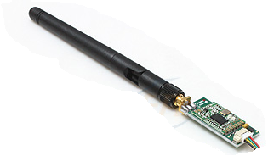
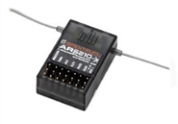
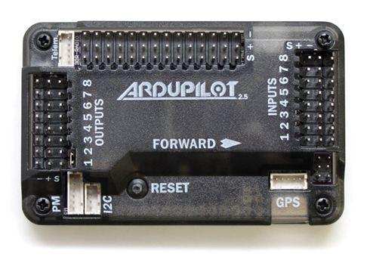
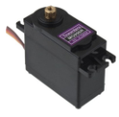
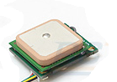
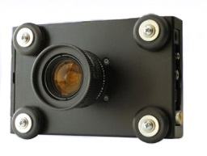
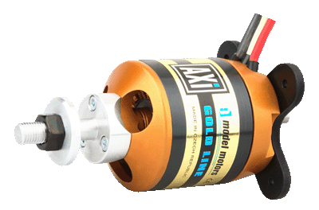
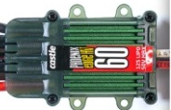
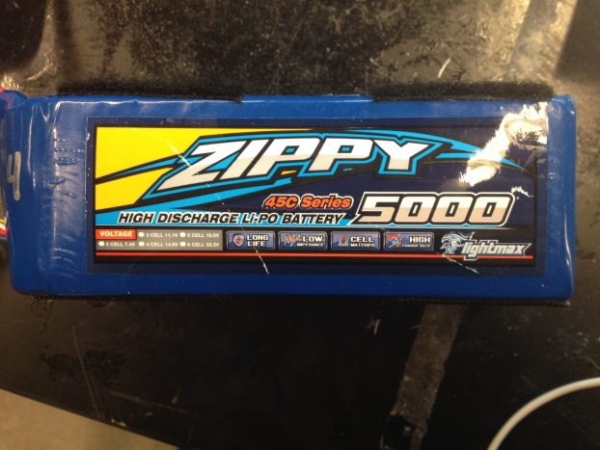
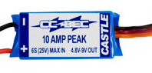
Avionics
Avionics wiring diagram shows integration of subsystems.
Telemetry
Radio Receiver
Ardupilot
Servos
GPS
Tetracam
ESC
BEC
Motor
Battery
15
Notes:
Mike K

Slide 16
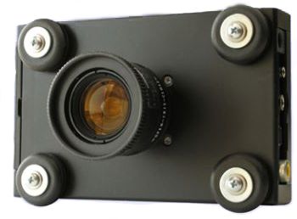



Payload
Tetracam ADC Lite & post-processor produce NDVI images.
Tetracam ADC Lite
NDVI Post-Processor
Stitching Software
Healthy Grass
Dead Grass
Mulch
Team 3D NDVI Image
16
Notes:
Mike K
Add labels

Slide 17
Detailed Analysis & Testing
17

Slide 18

CFD Analysis
Streamlines shown in blue
Spanwise flow demonstrated in WT not captured by CFD analysis
Discrepancies between WT, CFD, XFLR5
18
Notes:
Mike M
Flow visualization

Slide 19

Wind Tunnel Test
Test data shows analysis under-predicts drag, over-predicts lift.
19
Notes:
Mike M

Slide 20
Aerodynamics Analysis & Test
20

Slide 21
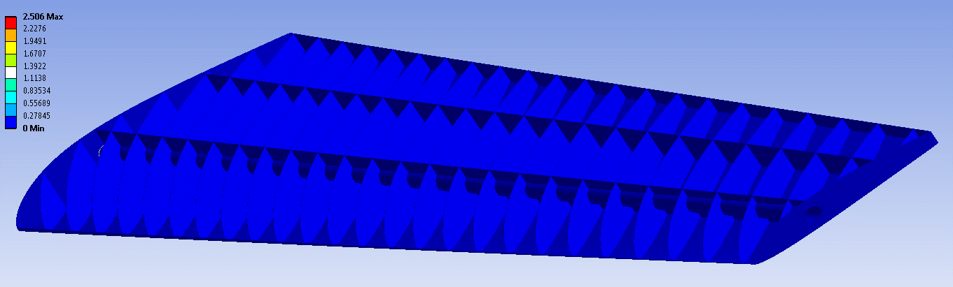
FEA Structural Analysis
Single ply wing with 15 lb_{f} tip load.
Max deflection is 2.5 in.
21
Notes:
Mike M

Slide 22

Structural Test
15 lb load shows skin dimpling but no plastic deformation.
22
Notes:
Mike M

Slide 23
Structural Analysis & Test
Initial ANSYS analysis showed 100% error; update shows 20-30%.
23
Notes:
Mike M
Use MATLAB script

Slide 24
Propulsion Test
Test performed with Hacker A40-12S at various airspeeds in WT.
24
Notes:
Mike M

Slide 25
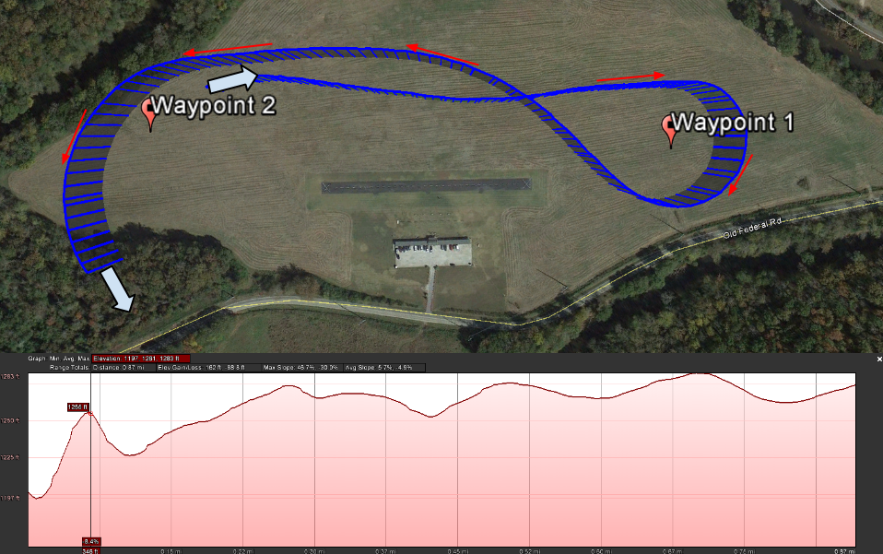
Flight Test
Flight data of foam prototype flying waypoints at GT AMA field.
25
Notes:
Nacho
Telemetry data

Slide 26
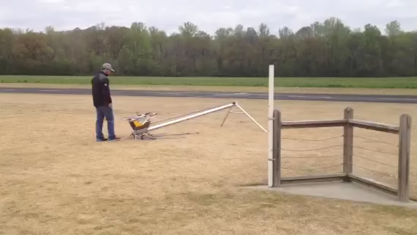
Launcher Test
Successful launch of test prototype with catapult launcher.
26
Notes:
Nacho

Slide 27
Manufacturing
27

Slide 28
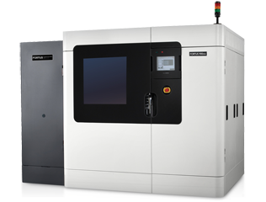
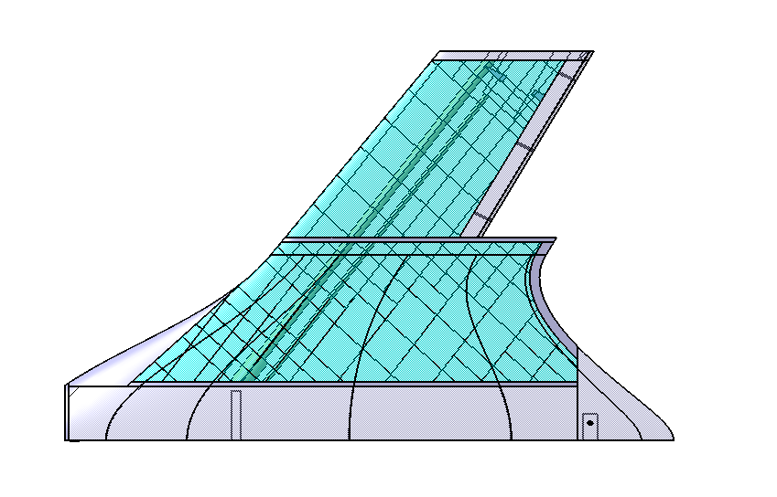
3D Printing Not Just for Prototyping Anymore!
Main sections printed at Stratasys using Fortus 900.
28
Notes:
Nacho

Slide 29
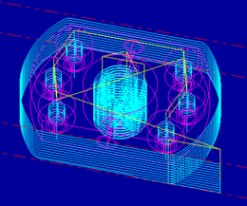
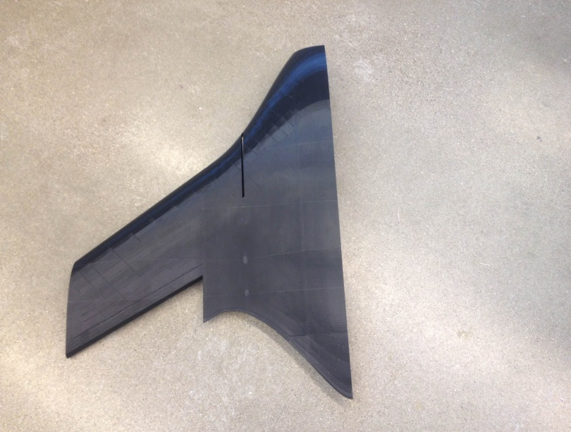
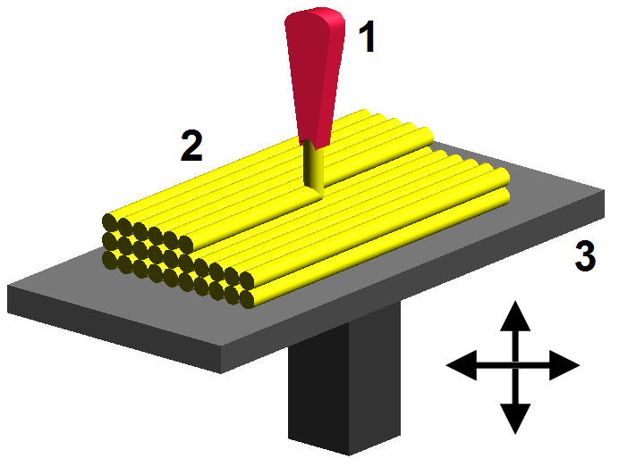
Fused Deposition Modeling
FDM uses an extruded thermoplastic filament to print parts.
Step 1: STL file
Step 2: Tool path
Step 4: Finished part
Step 3: Printer
29
Notes:
Nacho

Slide 30

Printing Without Support Material
Eliminating support material saves time & money.
$≤$45°
Notes:
Nacho

Slide 31
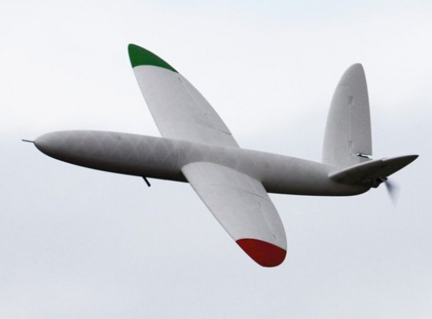
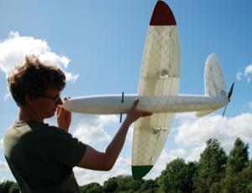
Why 3D Printing?
New frontier in aerospace manufacturing
Faster & cheaper than traditional methods
Reduced man hours
Little skill needed for assembly
31
Notes:
Nacho

Slide 32
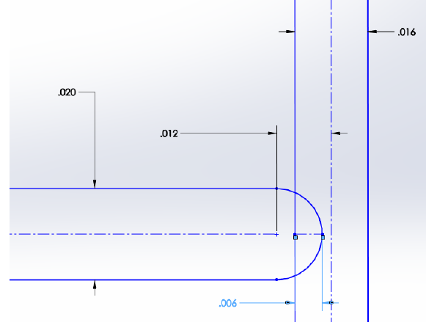
CAD Modeling for FDM
All thin parts (skin, ribs) are modelled as surfaces with 0.012” clearance to account for filament thickness.
Notes:
Nick

Slide 33
Solids vs. Surfaces
Surfaces printed as single layer, solids as honeycomb.
Bulkheads at joints
Internal ribs printed with skin
Carbon fiber spar
Solid to eliminate support mat’l
Reinforced skin around payload
Notes:
Nick

Slide 34


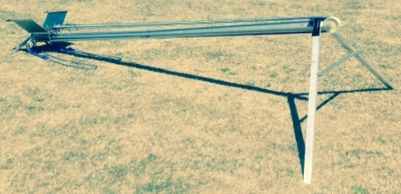



Manufacturing Collaboration
BYU: CAD Modeling
GT: Catapult build & test
PU: Final assembly
34
Notes:
Nick

Slide 35
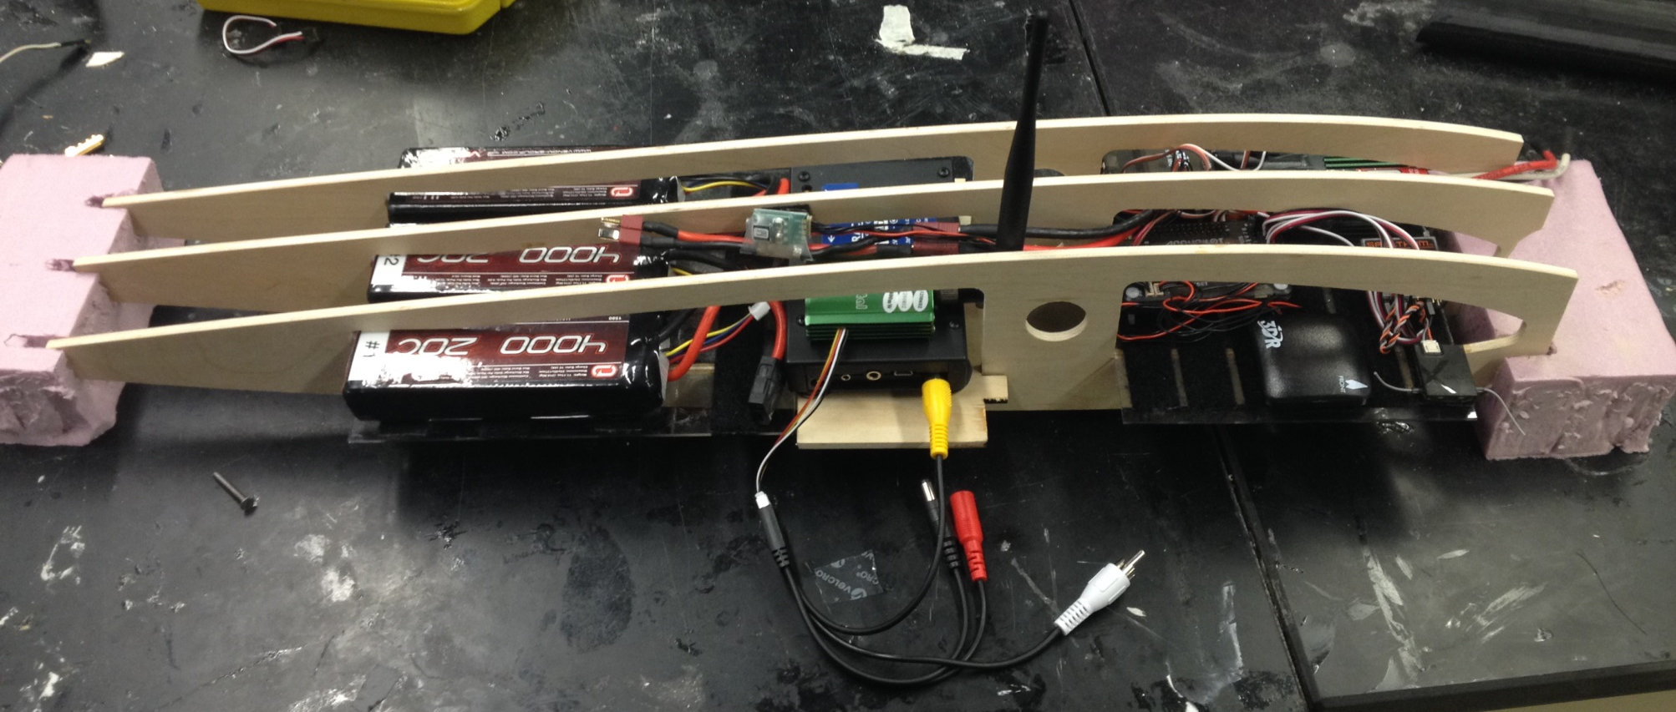
Tooling & Jigs
Very few jigs required...
35
Notes:
Nick

Slide 36
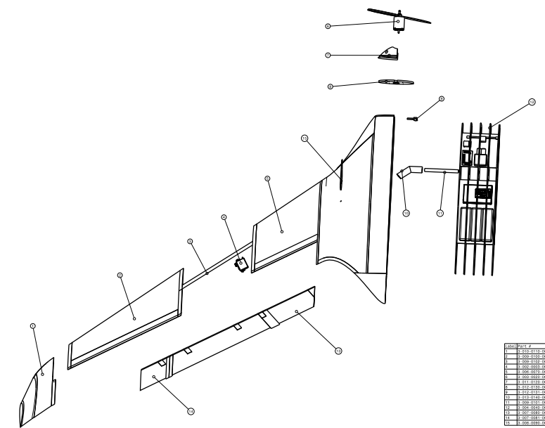
Assembly
Final assembly required some sanding & drilling but was relatively simple.
36
Notes:
Nick

Slide 37
Bill of Materials (1 of 2)
Section | Component | Qty | Details
Structures | L Body | 1 | 3D Printed Part
 | R Body | 1 | 3D Printed Part
 | L Wing | 1 | 3D Printed Part
 | R Wing | 1 | 3D Printed Part
 | L Winglet | 1 | 3D Printed Part
 | R Winglet | 1 | 3D Printed Part
 | L Elevon | 1 | 3D Printed Part
 | R Elevon | 1 | 3D Printed Part
 | Motor Cover | 1 | 3D Printed Part
 | Wing CF Spar | 2 | 0.5” x 32.5"pultruded CF tube spar
 | Body CF Spar | 2 | 0.5" x6" wrapped CF tube spar
Integration | Elevon hinge | 10 | Point hinge
 | Joining plate | 1 | Aluminum rectangular block
 | Joining screws | 2 | Machine screws & washers
 | Elevon set screws | 10 | Small wood screws
 | Torsion pins | 6 | 1/8" x 1" aluminum rod
Payload | NDVI imager | 1 | Tetracam ADC Lite
 | Camera battery | 1 | Zippy 2200 mAh 3S1 25C
 | Video transmitter | 1 | ReadyMadeRC 400mW 1300MHz
 | Payload Module | 1 | Plywood & acrylic shelf unit
37
Notes:
Nick

Slide 38
Bill of Materials (2 of 2)
Section | Component | Qty | Details
Propulsion | Motor | 1 | AXI 4130/16 electric motor
 | Motor Mount | 1 | Cross mount
 | Mounting Screws | 4 | Screws & washers supplied with motor
 | Mounting Nuts | 4 | Locking nuts
 | Propeller | 1 | 16x8" composite propeller
 | Battery | 1 | Zippy 5000mAh 6S 45C
 | Speed Controller | 1 | Castle phoenix edge lite HV 60
 | Battery Eliminator | 1 | Castle CC BEC 6S
Avionics | Autopilot | 1 | APM 2.5 Ardupilot
 | F-F Cables | 10 | 12 cm avionics wiring cables
 | M-F Cables | 10 | 30 cm servo cables
 | Receiver | 1 | Spektrum AR8000 8-channel
 | Elevon Servo | 2 | Hitec HS-465 MG
 | GPS & Compass | 1 | 3DR uBlox GPS w/ compass kit
 | Radio set | 1 | 3DR radio 915 MHz
38

Slide 39

Repairability
Individual components cannot be repaired, but replacement is fast & easy. In the future, users can print their own at home.
39
Notes:
Nick
New parts will be self-locating and can be replaced by the end user with only a screwdriver.
Printer shown is made for the home user at only $1300

Slide 40
Cost Update
Component | Cost
Payload | $4,500.00
Propulsion | $350.00
Avionics | $750.00
Battery | $130.00
Structure | $300.00
Servos | $170.00
Launch | $800.00
Total | $7,000.00
40
Notes:
Jean

Slide 41
Lessons Learned
Face-to-face kickoff meeting would be helpful
Define individual responsibilities early
Accountability improves productivity
Agendas improve meeting effectiveness
Schedule lectures & labs so all students can attend
Some private team meetings might lead to better cohesion
41
Notes:
Jean

Slide 42



Collaboration Tools
Used Google Hangouts but prefer Webex
Google Drive was most effective for file sharing
File organization & searching could improve CorpU
42

Slide 43
Conclusion
Designed & built UAS to satisfy agricultural mission
Ansys, Star CCM+, Catia, component testing
Gained exposure to FDM
Experienced long-distance collaboration
Notes:
Jean

Slide 44
Acknowledgements
Dr. John Sullivan
Eli Cohen
James Berlin (Stratasys)
The Boeing Company
Howard Horne
Adam Hadnott
Notes:
Jean

Slide 45
Questions?
Notes:
Jean

